Slide 1

Feature Scaling
Presented by:
Elizer Ponio Jr.
Department of Computer Science
College of Computing and Information Technologies

Slide 2
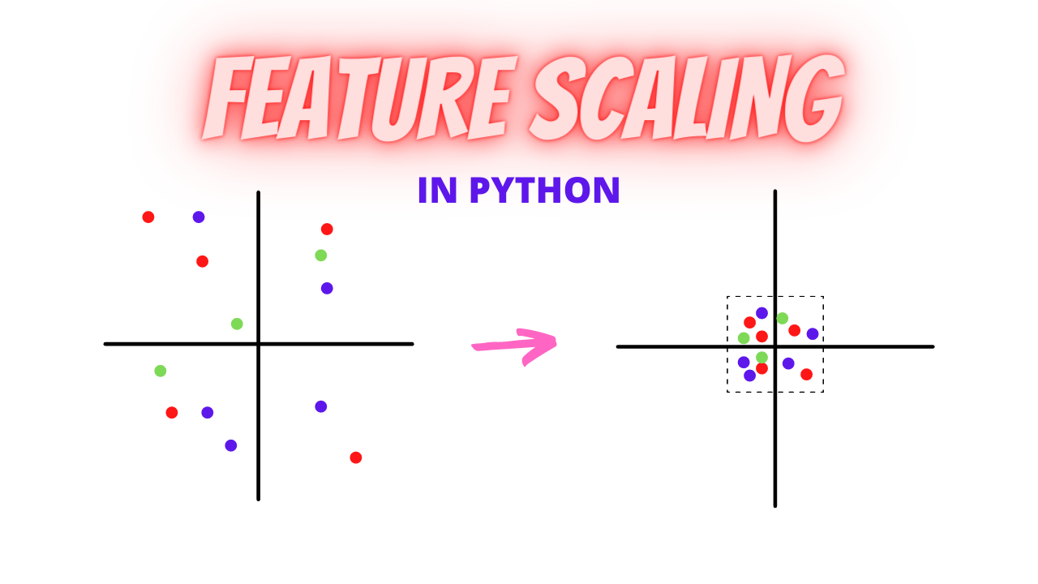
What is Feature Scaling?
In data pre-processing, we try to change the data in such a way that the model can process it without any problems.
Feature Scaling is one such process in which we transform the data into a better version.
Feature Scaling is done to normalize the features in the dataset into a finite range.

Slide 3
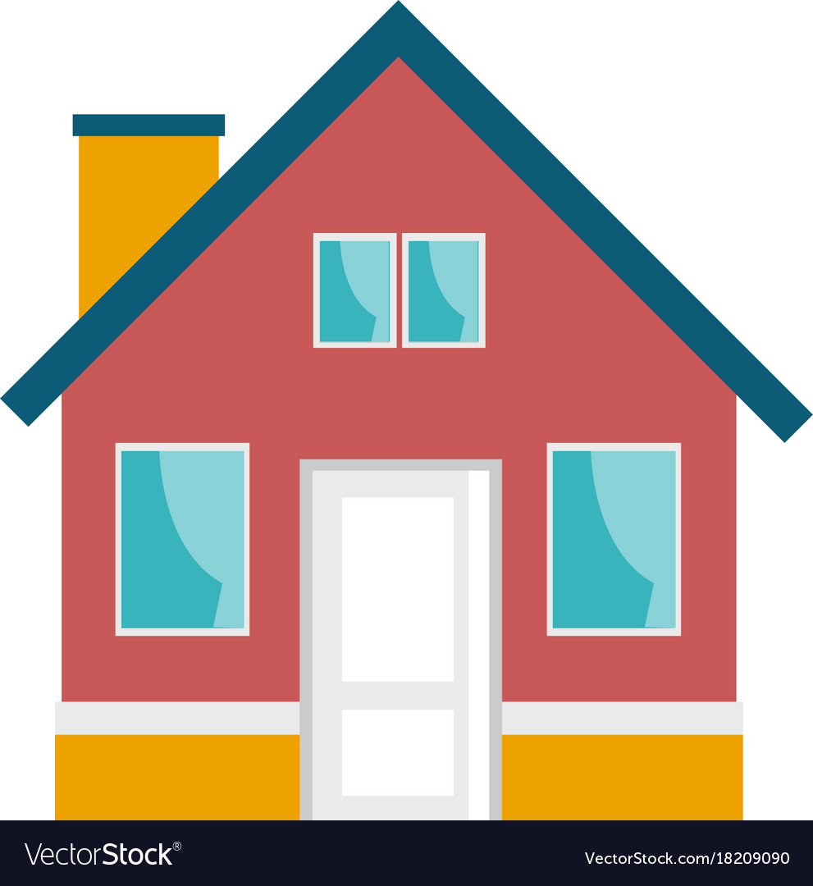
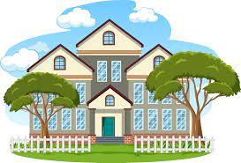
Why Feature Scaling?
Real Life Datasets have many features with a wide range of values

Slide 4
Why Feature Scaling?
For example, in a house price dataset. It will have many features such as number of bedrooms, square feet area of the house.
The number of bedrooms will vary between 1 and 5, but the square feet area will range from 500-2000.
This is a huge difference in the range of both features.
Number of Bedrooms: 2
Area: 500 sq. ft.
Number of Bedrooms: 5
Area: 2000 sq. ft.

Slide 5
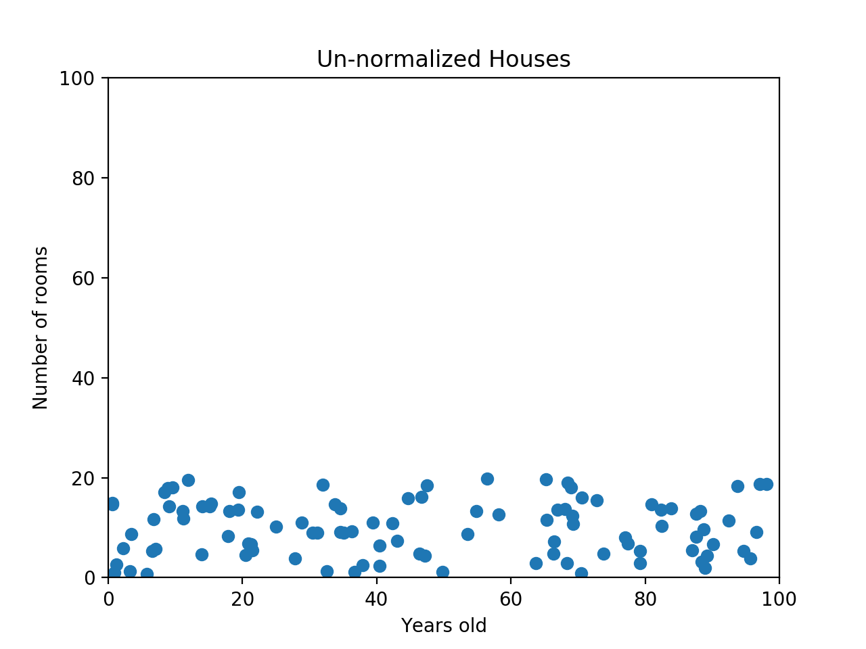
Why Feature Scaling?
For example, If we have a dataset like this, the machine learning algorithm should realize that there is a huge difference between a house with 2 rooms and a house with 20 rooms. But right now, because two houses can be 100 years apart, the difference in the number of rooms contributes less to the overall difference.

Slide 6
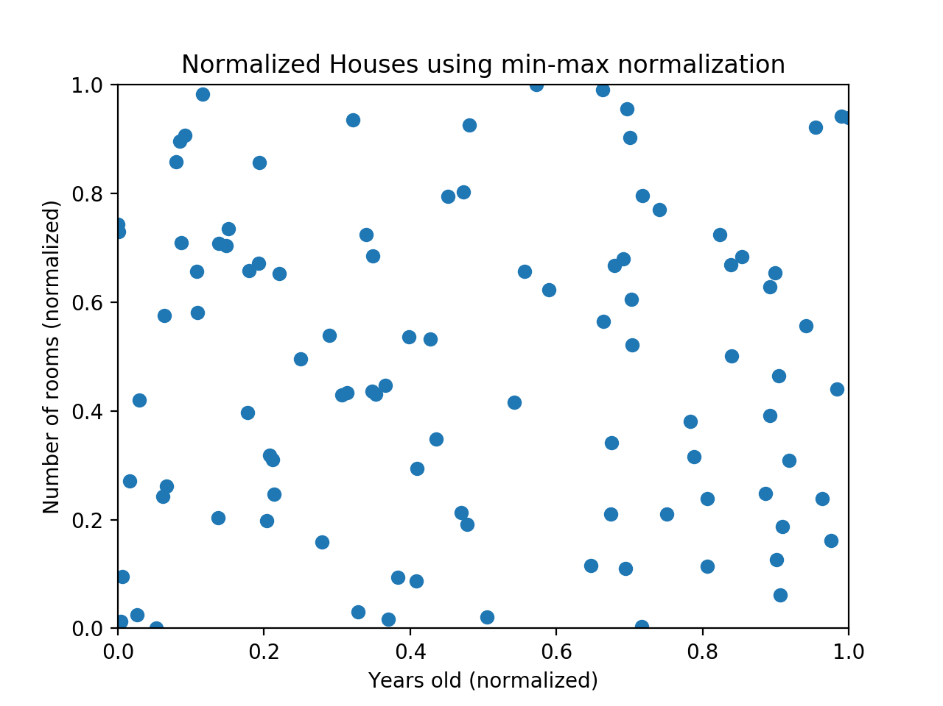
Why Feature Scaling?
The goal of normalization is to make every datapoint have the same scale so each feature is equally important.

Slide 7
Min-Max Normalization
Min-max normalization is one of the most common ways to normalize data. For every feature, the minimum value of that feature gets transformed into a 0, the maximum value gets transformed into a 1, and every other value gets transformed into a decimal between 0 and 1.

Slide 8
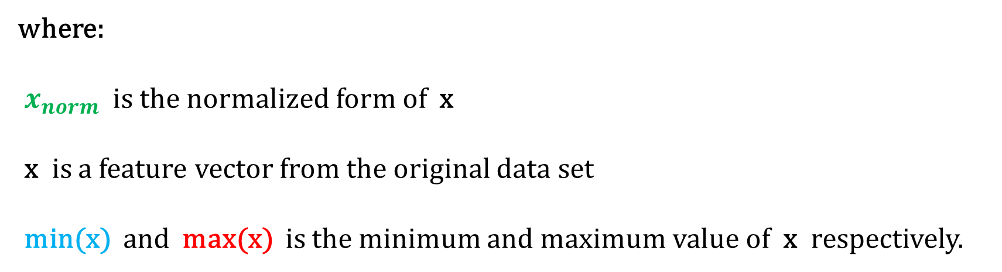
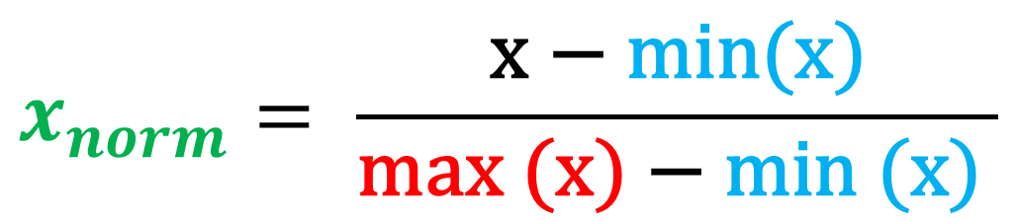
Min-Max Normalization
$$x_{norm}= \frac{\text{x} \text{− }\text{min}\text{(}\text{x}\text{)}}{\text{max} \text{(}\text{x}\text{) − }\text{min}\text{ (}\text{x}\text{)} }$$
where:
$x_{norm}$ is the normalized form of x
x is a feature vector from the original data set
min(x) and max(x) is the minimum and maximum value of x respectively.

Slide 9

Min-Max Normalization
$$x_{norm}= \frac{\text{x} \text{− }\text{min}\text{(}\text{x}\text{)}}{\text{max} \text{(}\text{x}\text{) − }\text{min}\text{ (}\text{x}\text{)} }$$
where:
$x_{norm}$ is the normalized form of x
x is a feature vector from the original data set
min(x) and max(x) is the minimum and maximum value of x respectively.

Slide 10
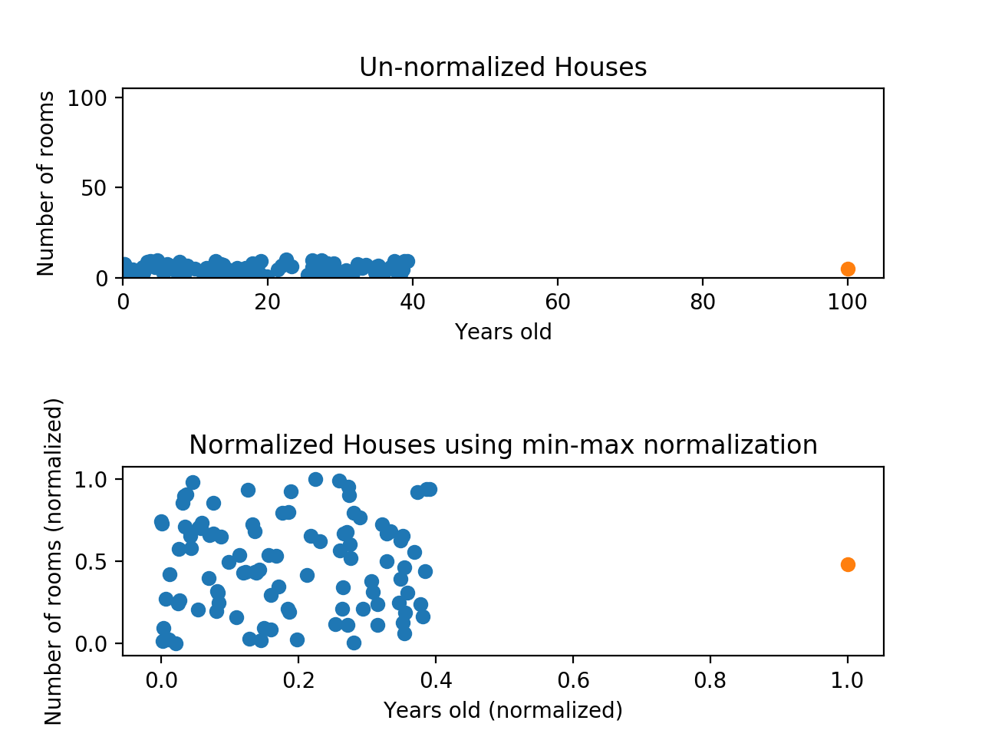
Min-Max Normalization
Min-max normalization has one fairly significant downside: it does not handle outliers very well. For example, if you have 99 values between 0 and 40, and one value is 100, then the 99 values will all be transformed to a value between 0 and 0.4.

Slide 11

Z-Score Normalization
Z-score normalization is a strategy of normalizing data that avoids the outlier issue. The formula for Z-score normalization is given by:
$$Z= \frac{\text{x} \text{− }mean}{\text{sd} }$$

Slide 12

Z-Score Normalization
$$Z= \frac{\text{x} \text{− }mean}{\text{sd} }$$
where:
Z is the normalized form of x
x is the feature vector from the original data set
mean is the mean of the feature vector x
sd is the standard deviation of x

Slide 13
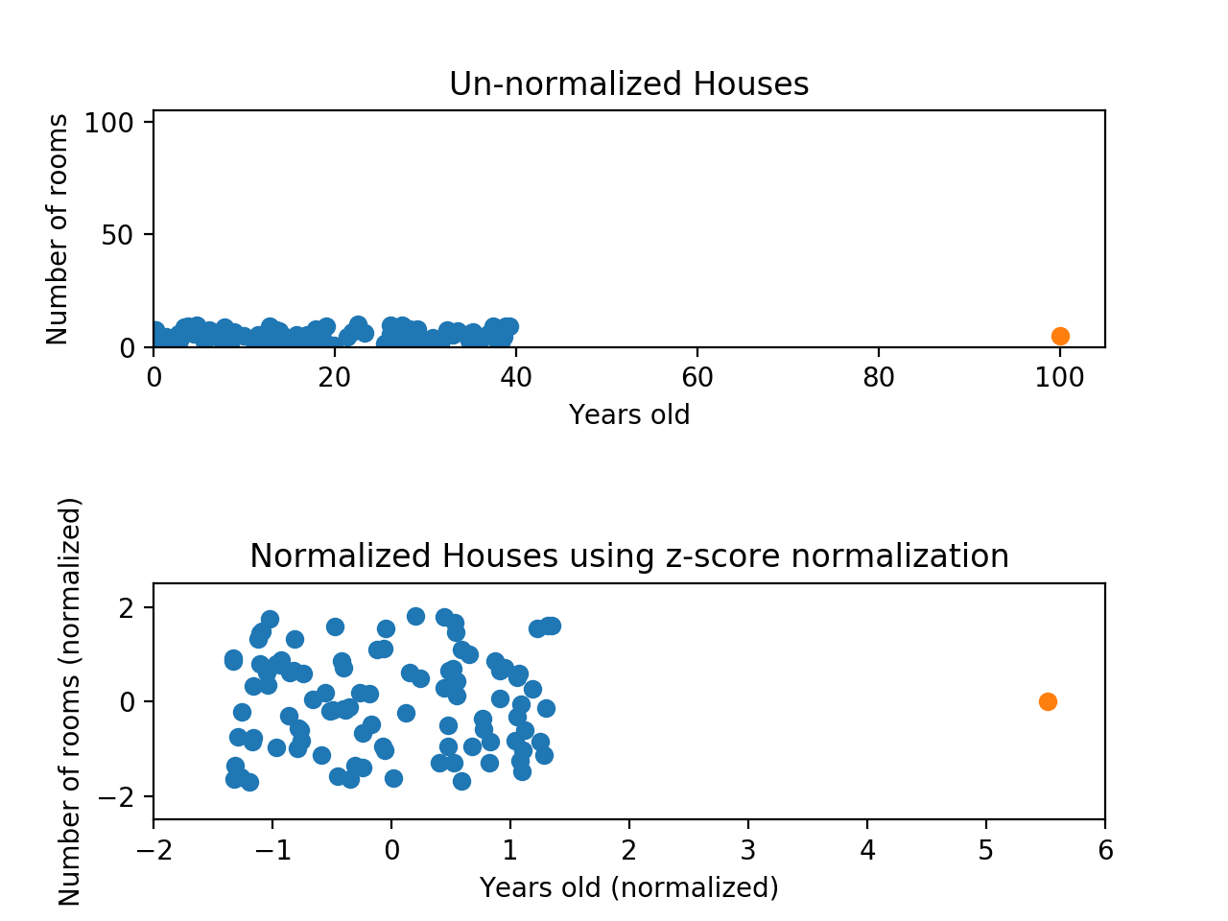

Z-Score Normalization
While the data still looks squished, notice that the points are now on roughly the same scale for both features — almost all points are between -2 and 2 on both the x-axis and y-axis. The only potential downside is that the features aren’t on the exact same scale.

Slide 14
Min-Max Normalization
With min-max normalization, we were guaranteed to reshape both of our features to be between 0 and 1. Using z-score normalization, the x-axis now has a range from about -1.5 to 1.5 while the y-axis has a range from about -2 to 2. This is certainly better than before; the x-axis, which previously had a range of 0 to 40, is no longer dominating the y-axis.

Slide 15
Summary
Normalizing your data is an essential part of machine learning. You might have an amazing dataset with many great features, but if you forget to normalize, one of those features might completely dominate the others. Normalizing solves this problem.

Slide 16
Summary
Min-max normalization: Guarantees all features will have the exact same scale but does not handle outliers well.
Z-score normalization: Handles outliers, but does not produce normalized data with the exact same scale.

